Slide 1
Data Modelling Session Module-1
Notes:
For information on applying this template to an existing presentations, refer to the notes on slide 2 of this presentation.
The Input area of the Beam can be customised to reflect the content of the presentation. The Input area is an AutoShape with a picture fill. To change this, ensure you have the image you wish to use (ideally a .jpg or a .png file) in an accessible folder. The image should have a ratio of 1:1 to ensure it does not appear distorted. It is not possible to reposition the image within the Input area.
Acceptable images for importing into the Input area of the Beam are the three approved graphics (lines), and black and white photography or illustrations which follow the principles laid out on The Branding Zone. Colour images should never be imported into this area. Please be aware that replacing the Input area with high resolution graphics will significantly increase the file size. Contact your local DDC for assistance with updating the Beam.
Customise the Input area of the Beam as described below.
Click on the View tab from the menu bar and select Master>Slide Master
Right-click on the Input graphic and select Format AutoShape
From the Fill menu, under the Colour and Lines tab, click on the drop-down arrow next to Colour and select the Fill Effects menu
From the Picture tab, click on Select Picture. Navigate to the folder containing the image you wish to insert in the Input area. Highlight the image and tick the Lock picture aspect ratio box. Click on OK
You can now preview the image before continuing. If you are happy with how it looks, click OK to continue. Otherwise, repeat the process until you are happy with your selected image
To exit from Master View, click on View>Normal. The change you made to the Input graphic should now be visible on the title slide.

Slide 2
Introduction
Module-1:
1. Data Modelling Fundamentals - What is it, purpose, etc.
2. The building block of Data Models - Entity, Attributes, Relationship
3. Type of Data Models - Conceptual, Logical, Physical
Module-2:
1. Normalization
2. Relationship & cardinality (1:1, 1:M, M:M)
3. Data Modelling notation
4. Introduction to Dimension Modelling
Module-3:
1. Type of Dimension Models - Star Schema, Snowflake Schema, etc.
2. Different types of Dimensions & fact table
3. Difference between OLTP & OLAP Modelling.

Slide 3
Data Modelling
What is Data Modelling?

Slide 4
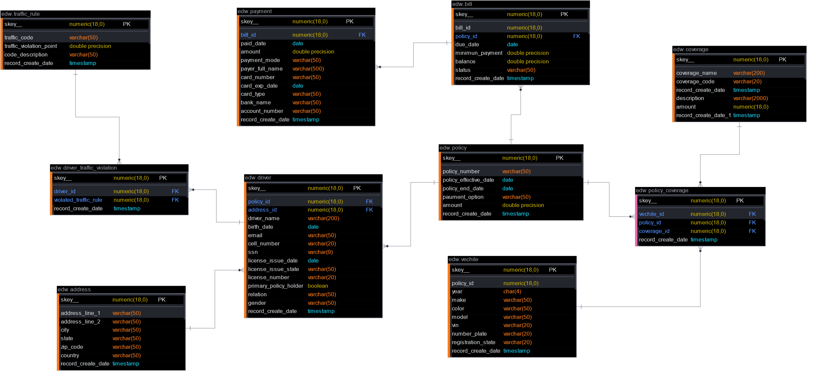
Data Modelling – Definition, Purpose
What data an organization collects,
In which section of the organization, it is collected and stored
How we store data, and how each data relate to others.

Slide 5
Database, Data Models & Tables
Database
Data Model
Data Model
Data Block
1
Data Block
1
Data Block
2
Data Block
1
Data Block
2
Data Block
1

Slide 6
Data Modelling
Data Model
Hierarchical Model
Network Model
Entity Relation Model
Relational Model
Object Relation Model
Business-1
Employee
Organization
Employee
“attributes:
{
“Name”: ”Atanu”,
“Salary”:100
}
“method”:
Get_Department()
Employee
M:1
M:1
IT
HR
Business-1
Business-1
work
Employee
Finance
IT
Department
Department
Department
“Attribute”:
{
“Department ID”: 1,
“Name”:”IT”
}
“method”:
Change_department()
Employee

Slide 7
Data Modelling
Building Blocks Of Data Modelling

Slide 8
Building Blocks - Data Model
Entities represent data tables (or more generally, data objects) that contain data relevant for comparison.
Attributes show additional information stored under each unique ID in an entity.
Relationships are shown by lines and symbols and explain how entities interact.
Entities
Attributes
Relationships
ER Model
ID
ID
Derived Attribute
Driver
M
drives
M
Vehicle
name
cell
VIN
colour
age
address
model
Multivalued Attribute
SSN

Slide 9
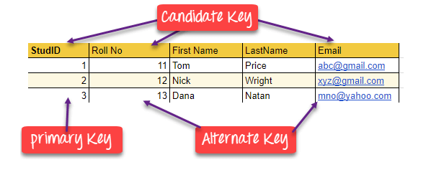
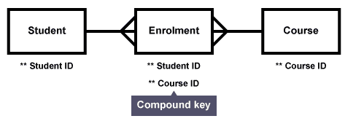
Types of Key(s)
Super Key – A super key is a group of single or multiple keys that identifies rows in a table.
Primary Key – is a column or group of columns in a table that uniquely identify every row in that table.
Candidate Key – is a set of attributes that uniquely identify tuples in a table. Candidate Key is a super key with no repeated attributes.
Alternate Key – is a column or group of columns in a table that uniquely identify every row in that table.
Foreign Key – is a column that creates a relationship between two tables. The purpose of Foreign keys is to maintain data integrity and allow navigation between two different instances of an entity.
Compound Key – has two or more attributes that allow you to uniquely recognize a specific record. It is possible that each column may not be unique by itself within the database.
Composite Key – is a combination of two or more columns that uniquely identify rows in a table. The combination of columns guarantees uniqueness, though individual uniqueness is not guaranteed.
Surrogate Key – An artificial key which aims to uniquely identify each record is called a surrogate key. These kind of key are unique because they are created when you don’t have any natural primary key.

Slide 10
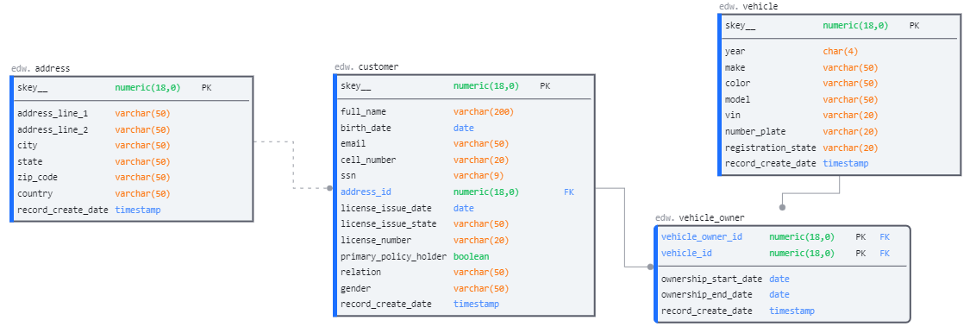
Relationship
Identifying Vs Non-identifying

Slide 11
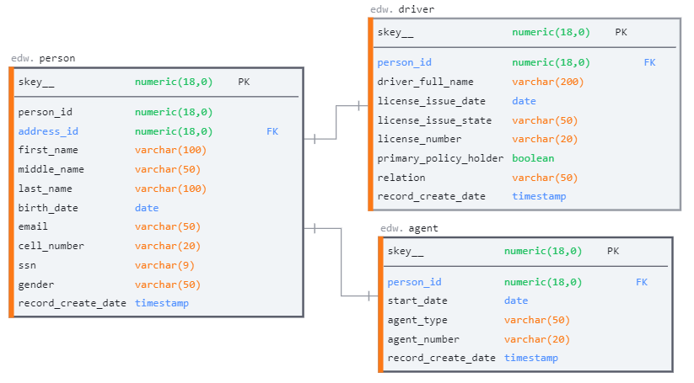
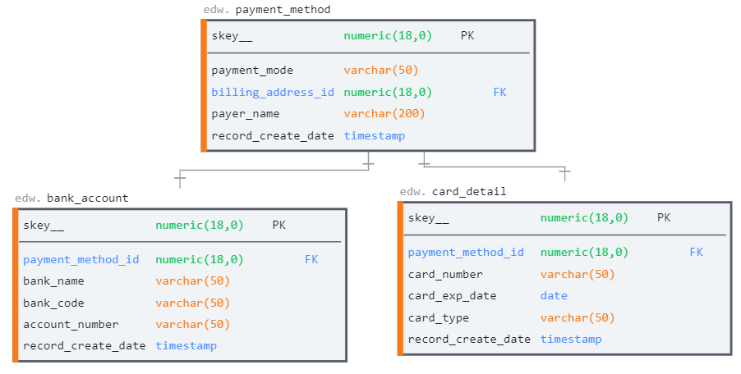
Relationship (Sub Type)
Exclusive Sub Type
Inclusive Sub Type

Slide 12
Relationship (continue)
The cardinality of a join between two tables is the numerical relationship between rows of one table and rows in the other.
Relationship | Example | Left | Right | Narrative
One-to-one | Driver ←→ Driving License | 1 | 1 | A Driver must have their driving license
One-to-one (optional on one side) | Driver ←→ International Driving License | 1 | 0..1 or ? | A Driver may have internation permit
Many-to-one | Driver ←→ Location | 1..* or + | 1 | Many people/drivers can be from the same place
Many-to-many (optional on both sides) | Driver ←→ Traffic Rule Violation | 0..* or * | 0..* or * | A Driver may or may not violated traffic rules
One-to-many | Policy ←→ Coverage | 1 | 1..* or + | A policy contains at least one coverage
Many-to-many | Driver ←→ Vehicle | 1..* or + | 1..* or + | Driver drives various vehicle

Slide 13
Phases of Data Modelling

Slide 14
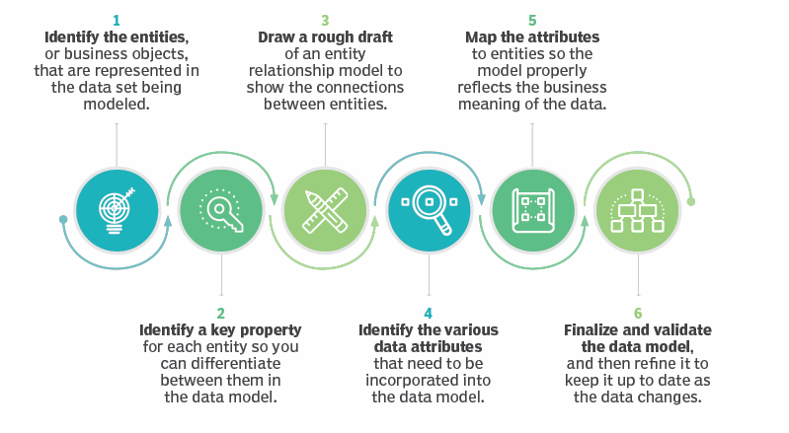
Key Steps of Data Modelling
Credits: https://www.techtarget.com

Slide 15
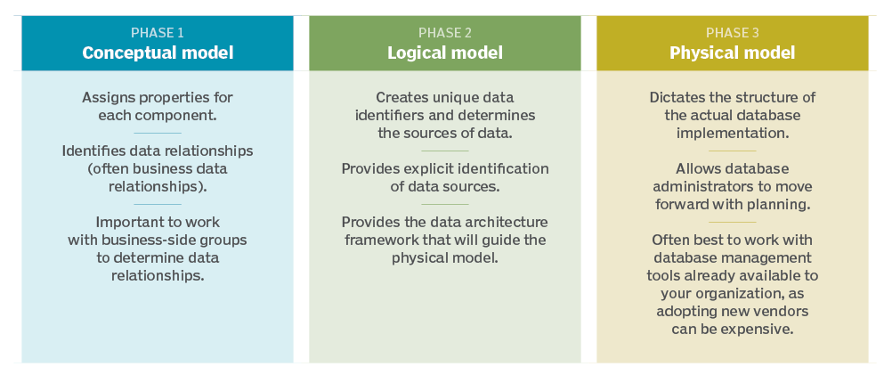
Phases of Data Modelling
Credits: https://www.techtarget.com

Slide 16
Data Modelling Use Case
Create a database for a small Auto insurance company
Sigle policy can have one or more coverage
Policy holders can have more than one policy
Partial payment is possible for a policy bill
Discount to be offered for not violating traffic rules

Slide 17
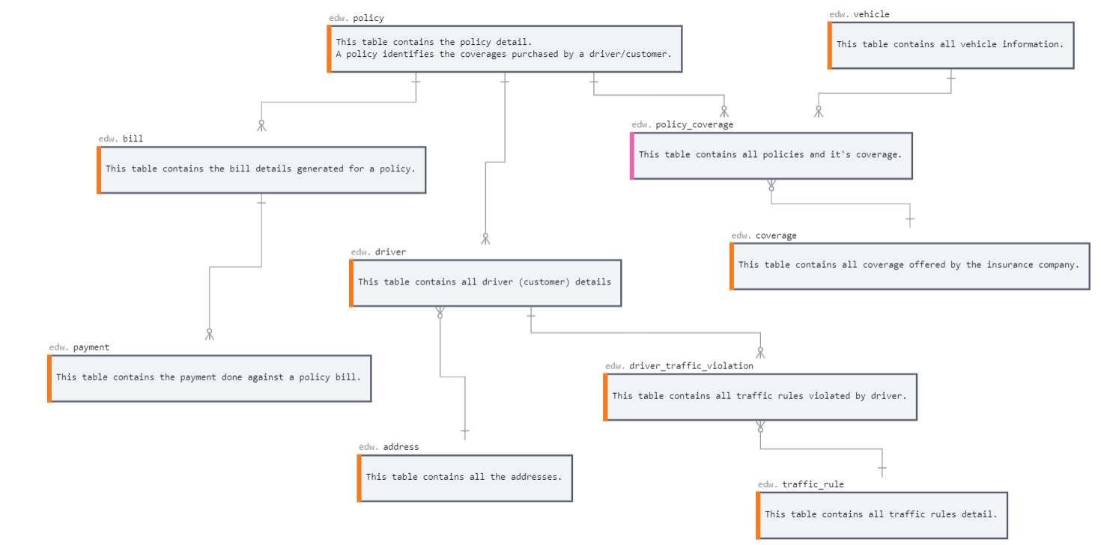
Conceptual
Represents the overall structure and content but not the detail of the data plan
High-level blueprint for the development of logical and physical models.

Slide 18
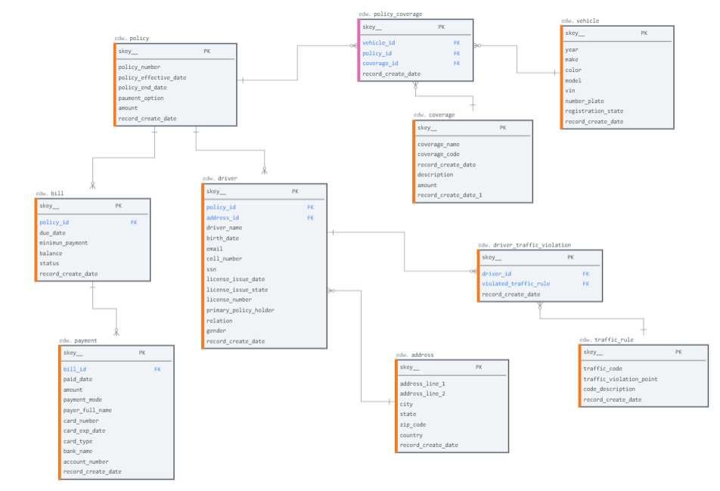
Logical
Closely relates to the general definition of “data model” in that it describes the data flow and database content.
This adds detail to the overall structure in the conceptual model but does not include specifications for the database.

Slide 19
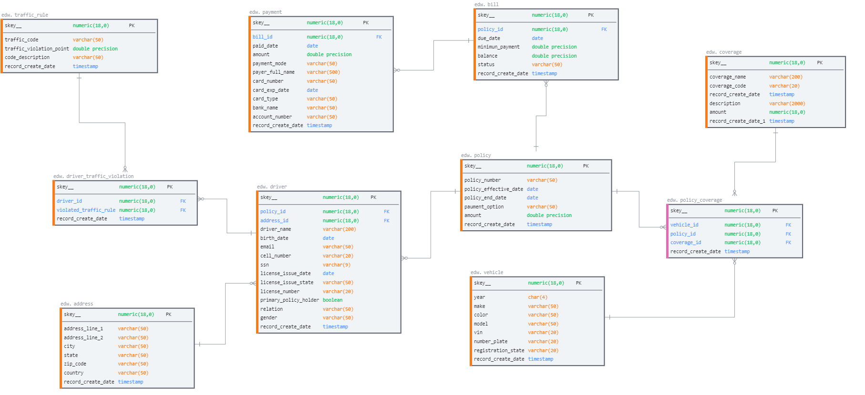
Physical
Contain enough detail to enable technologists to create the actual database structure.
The physical data model is specific to a designated database software system.

Slide 20
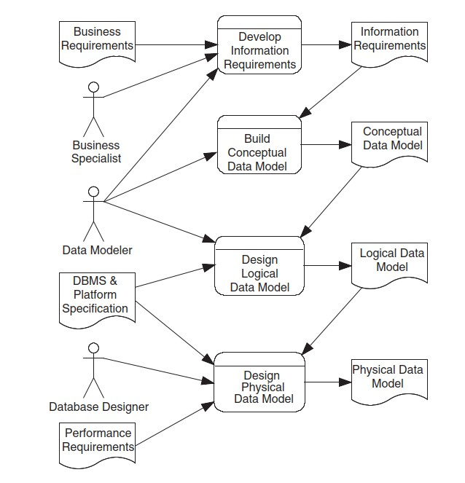
Database Design Stages and Deliverables

Slide 21
Thank You

